Slide 1

Web Application Penetration Test — DVWA (Damn Vulnerable Web Application)
Analyst: Ramjith M – Group-6
Date: 22 June 2025
Target: DVWA (Local Instance, Low Security Mode)
Tools: Burp Suite, Browser payloads, manual testing

Slide 2

DVWA Penetration Test Report
OWASP Top 10 Vulnerability Assessment
This report details a penetration test conducted on the Damn Vulnerable Web Application (DVWA). The primary purpose was to enhance web security awareness by identifying and exploiting common vulnerabilities in a controlled lab environment. The assessment was performed in DVWA's low-security mode, utilising tools such as Burp Suite for traffic interception and manual testing with various browser payloads.

Slide 3

Scope and Methodology
Scope
Target: Local instance of DVWA
Focus: Exploitation of OWASP Top 10 vulnerabilities
Methodology
Reconnaissance via Burp Suite proxy
Manual payload testing for SQL Injection, Cross-Site Scripting (XSS), and Command Injection
Brute-force attacks on authentication mechanisms
Cross-Site Request Forgery (CSRF) testing
Sensitive data inspection for insecure handling
Each identified vulnerability was mapped directly to its corresponding category within the OWASP Top 10 list for standardised reporting and categorisation.

Slide 4
Key Vulnerabilities Discovered
SQL Injection (Critical)
Command Injection (Critical)
Reflected XSS (Medium)
Full database access achieved through ' OR '1'='1-- payload, bypassing authentication and enabling data exfiltration.
Non-persistent XSS attack vectors identified, leading to client-side script execution upon user interaction with a malicious link.
Operating system command execution demonstrated with 127.0.0.1|pwd, allowing arbitrary command execution on the server.
Stored XSS (High)
Brute Force (Medium)
Persistent Cross-Site Scripting vulnerability found in the guestbook, allowing for stored malicious scripts to affect all users viewing the page.
Weak login credentials were successfully exploited using brute-force techniques, compromising user accounts.

Slide 5
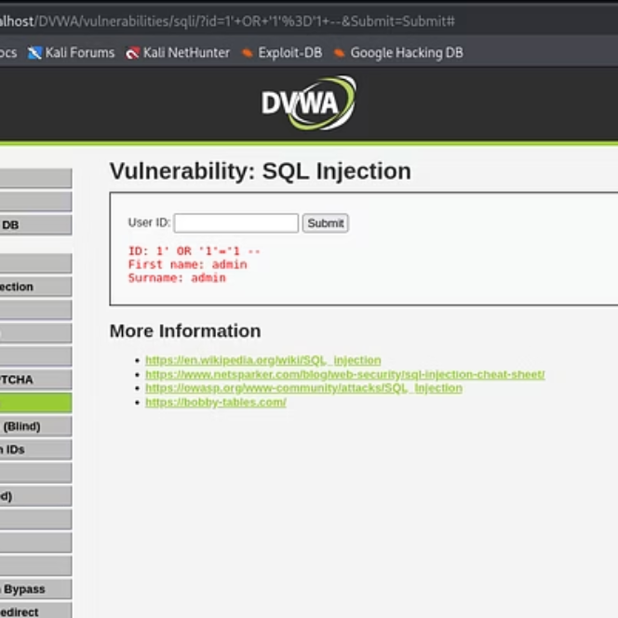
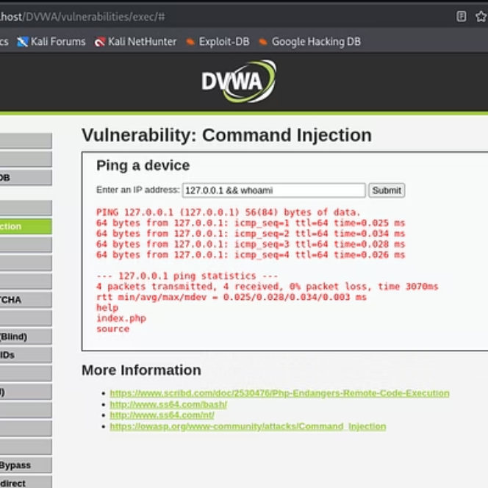
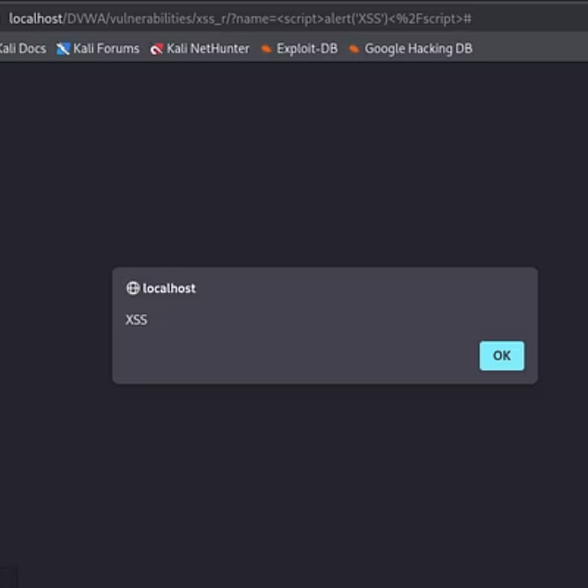
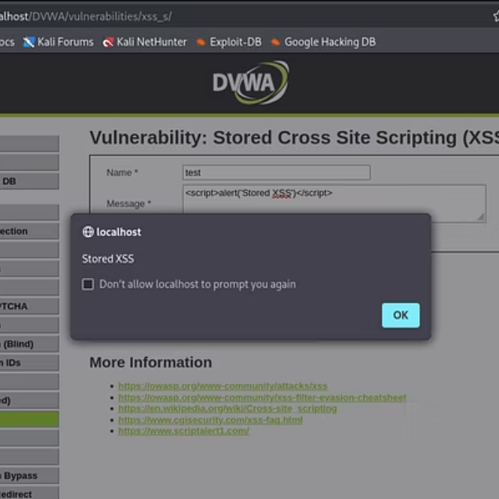
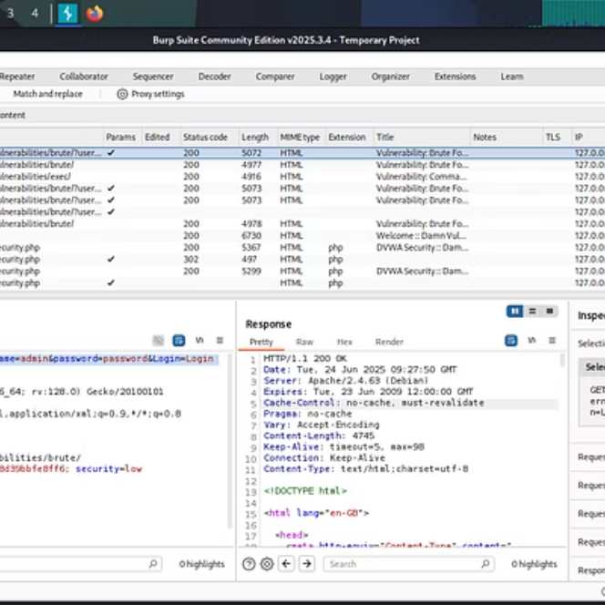
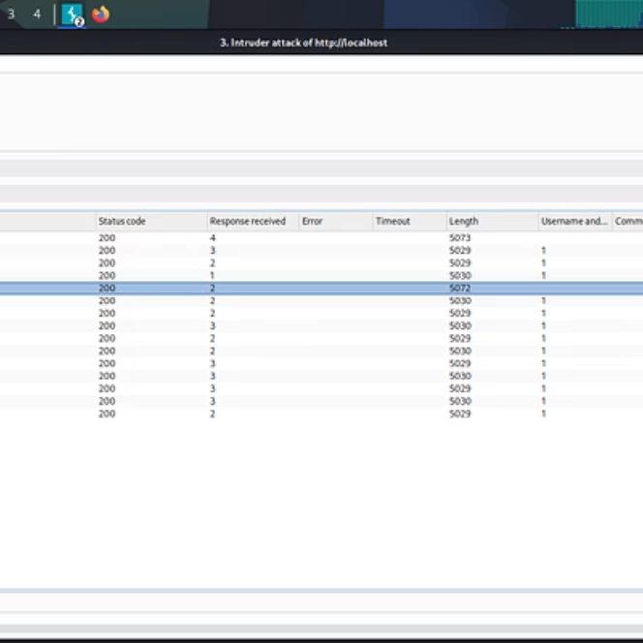
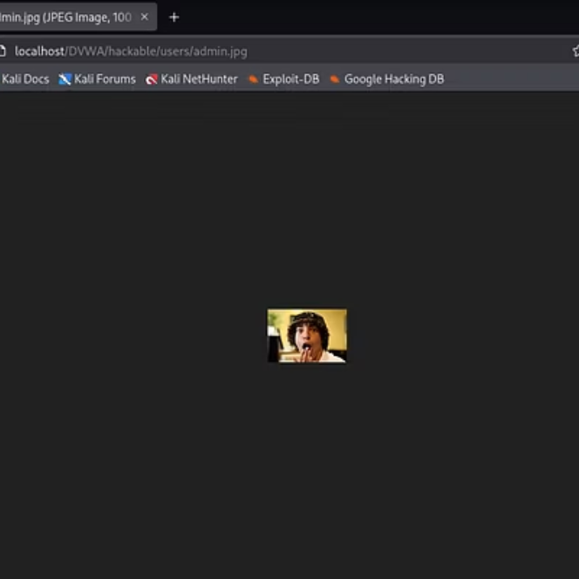
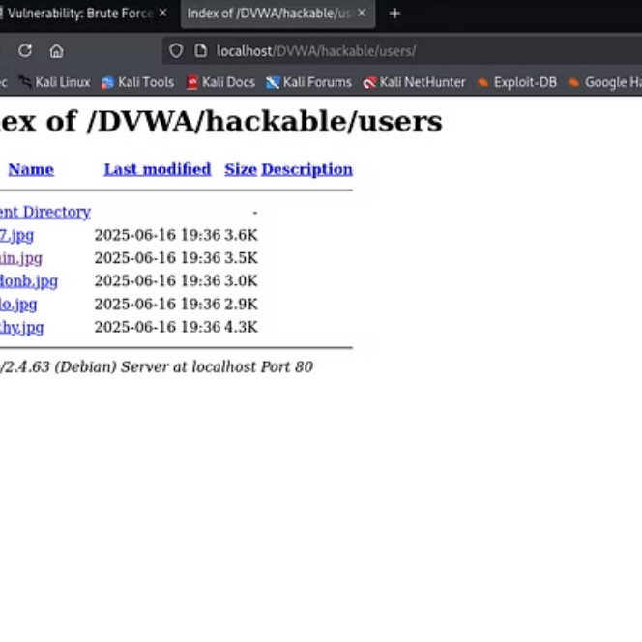
Supporting Evidence
Proof-of-concept screenshots are included in the full report to visually demonstrate the exploitation of each vulnerability and validate the findings.

Slide 6
Additional Findings
Cross-Site Request Forgery (CSRF)
Sensitive Data Exposure
Though no major exploit was achieved, the lack of CSRF tokens was noted. Recommendations include implementing anti-CSRF tokens for all state-changing requests to prevent unintended actions.
Credentials were transmitted over HTTP in plaintext and sensitive information was exposed in URLs, indicating a critical need for TLS enforcement and secure data handling.
Broken Access Control
Security Misconfiguration
While not directly exploitable in the low-security mode, the underlying architecture demonstrated potential for privilege escalation if security controls were not properly configured. Further testing in higher security modes is recommended.
The DVWA instance was running in low-security mode, which inherently demonstrates various misconfigurations. This highlights the importance of regular security audits and hardening of web server configurations.

Slide 7
Conclusion & Recommendations
DVWA, by design, serves as an excellent platform to demonstrate real-world web application risks. This test highlighted critical vulnerabilities that attackers commonly exploit.
Key Recommendations:
Implement Parameterized Queries and Prepared Statements to mitigate SQL Injection.
Apply robust Input Validation and Output Encoding/Sanitization for all user-supplied data to prevent XSS and Command Injection.
Learning Outcome: This engagement provided invaluable practical experience in exploiting and understanding remediation strategies for the OWASP Top 10 vulnerabilities.
Enforce HTTPS/TLS across the entire application to protect sensitive data in transit.
Strengthen Authentication Mechanisms by enforcing strong password policies, multi-factor authentication, and rate limiting.
Ensure Secure Configuration of all web servers, application servers, and frameworks, moving away from default settings.
Implement Anti-CSRF Tokens for all state-changing requests.

